Slide 1
Texture Mapping & Environmental Mapping

Slide 2
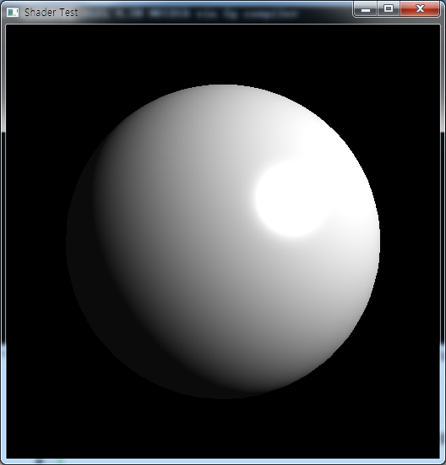
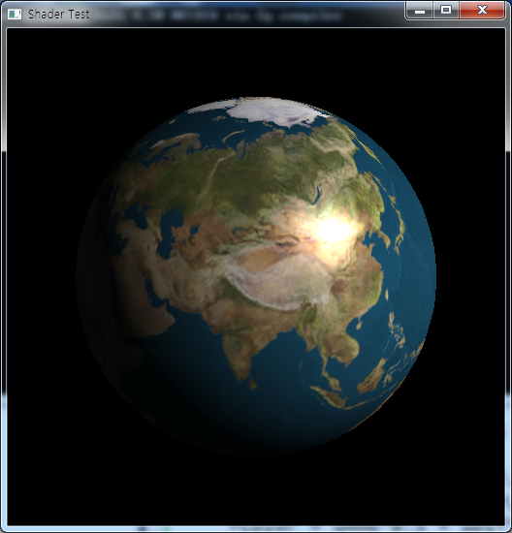
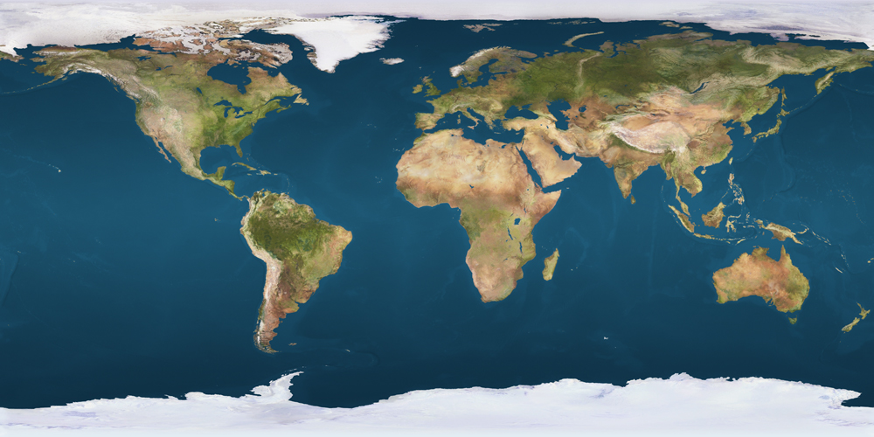
Coding practice: planet earth

Slide 3
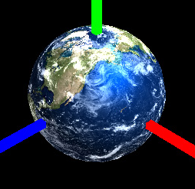
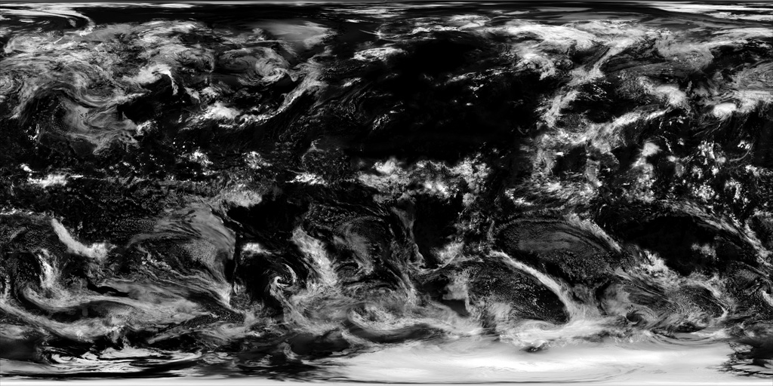
Multi-Texturing
Apply multiple textures at the same surface:

Slide 4
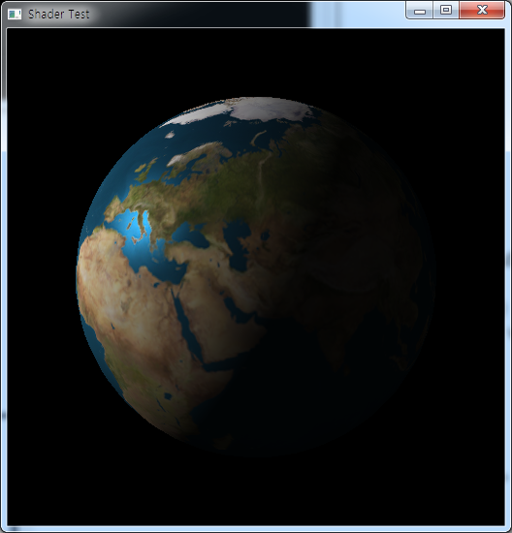
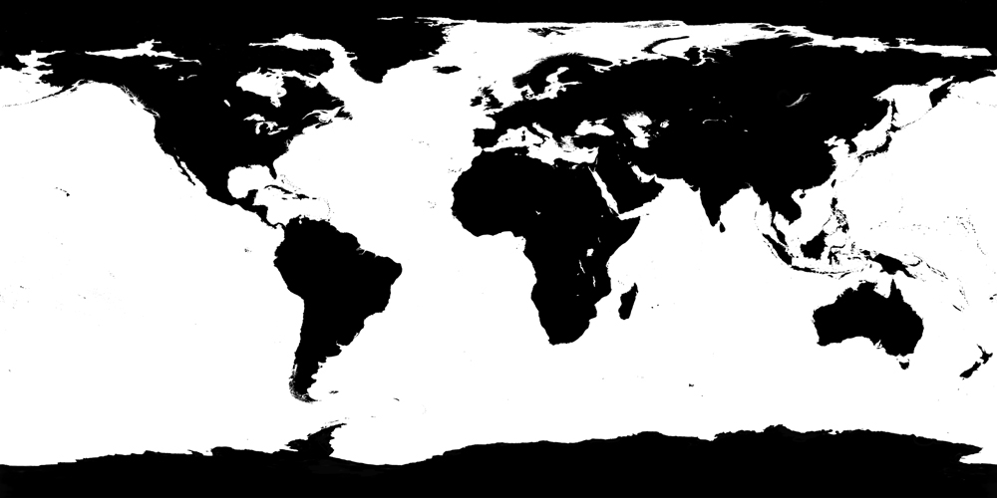
Multi-texturing: Specular Map:
Specify the specular reflectance by giving the additional texture (specular map)

Slide 5
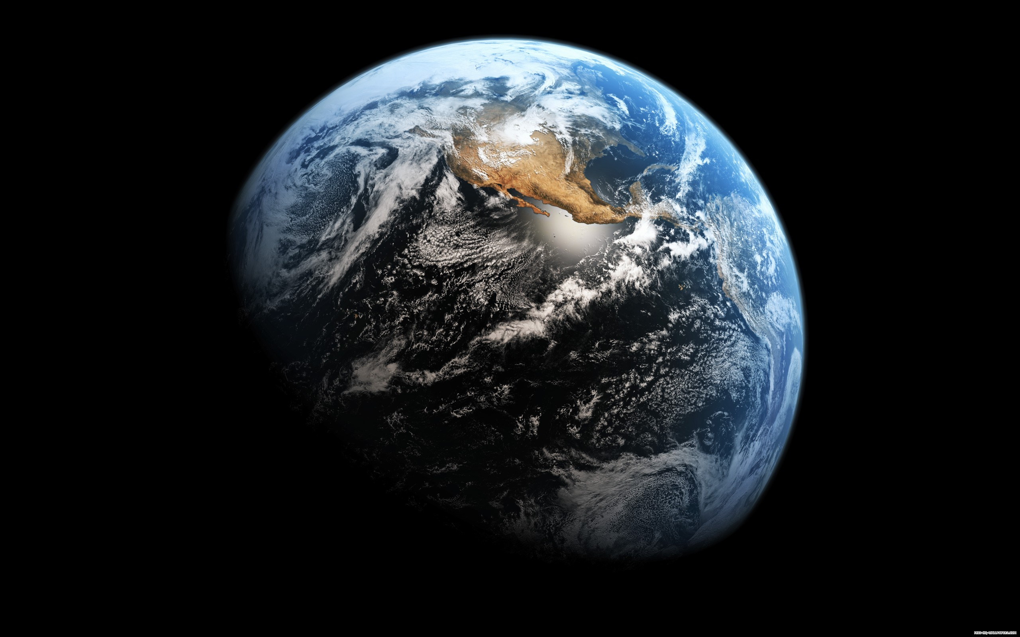
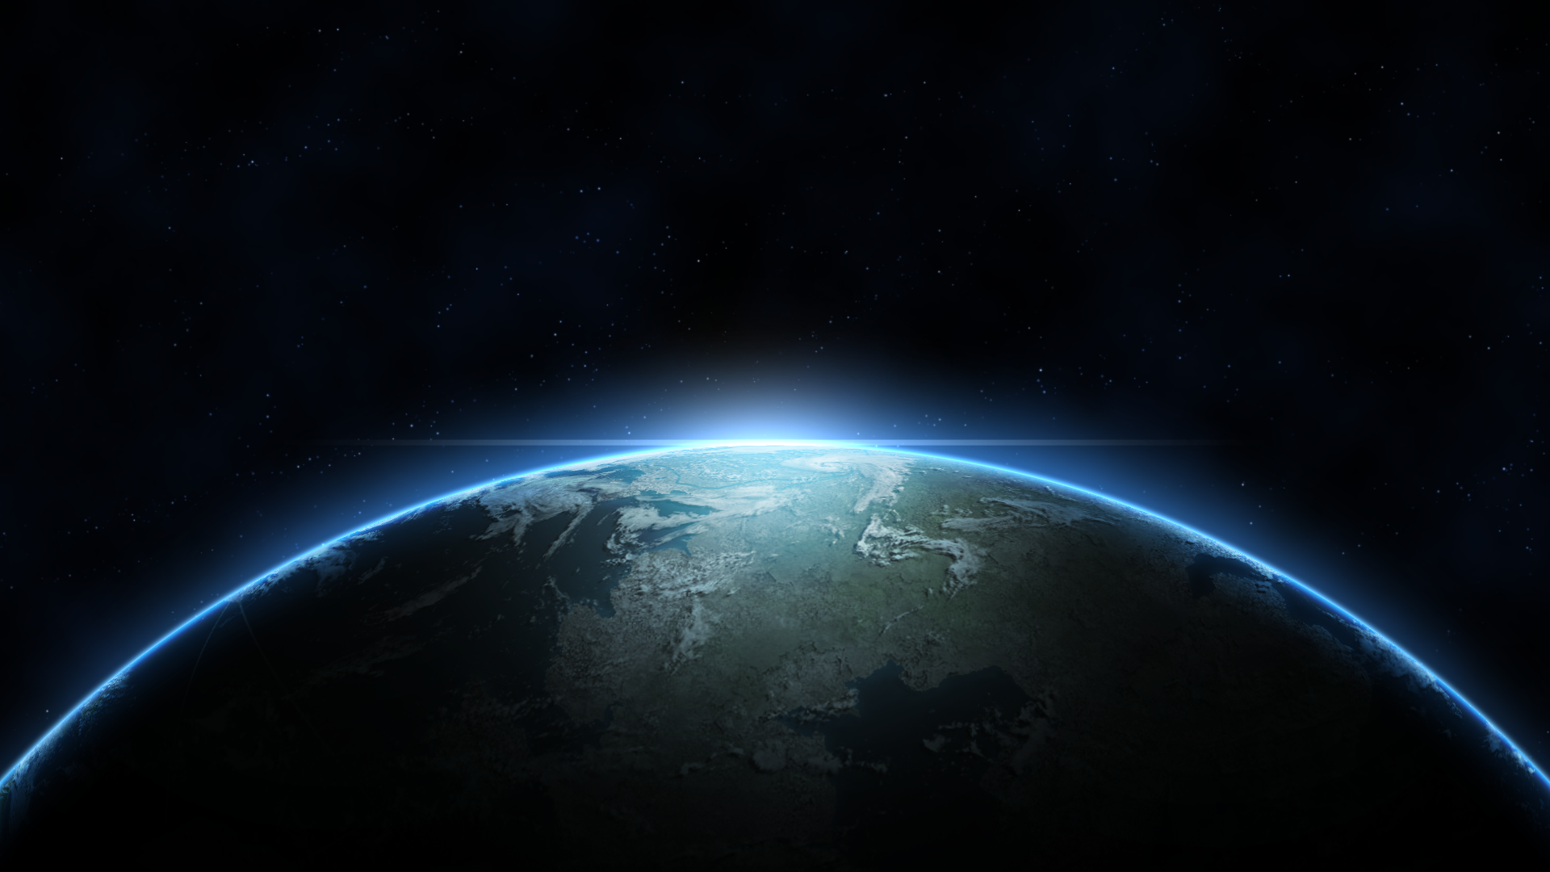
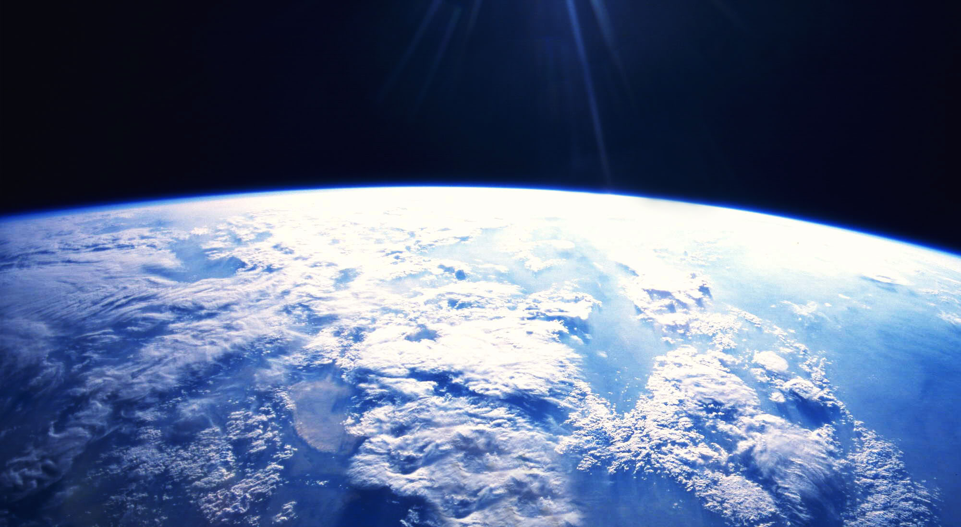
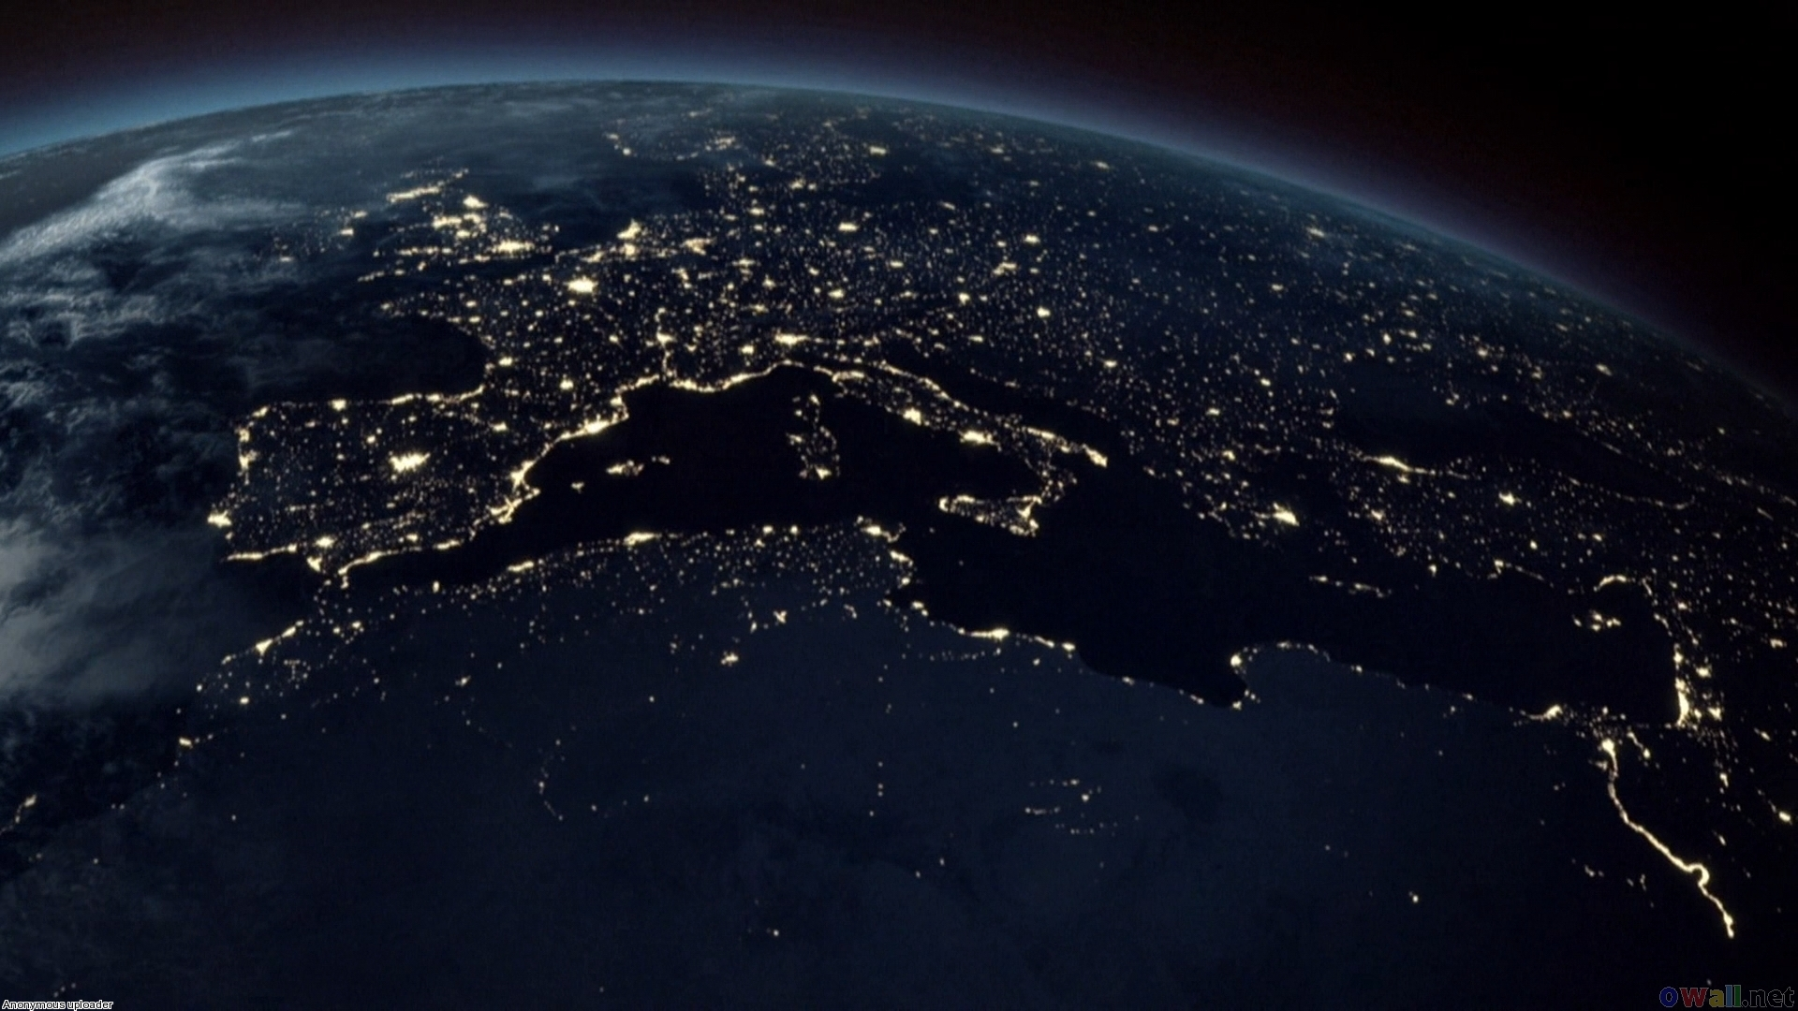
Think more:
Observe the photos of the earth
What effects you need more and how to do implement?

Slide 6
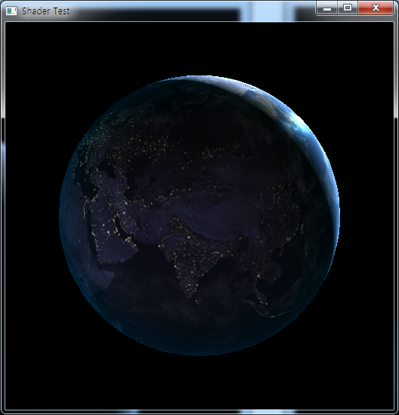
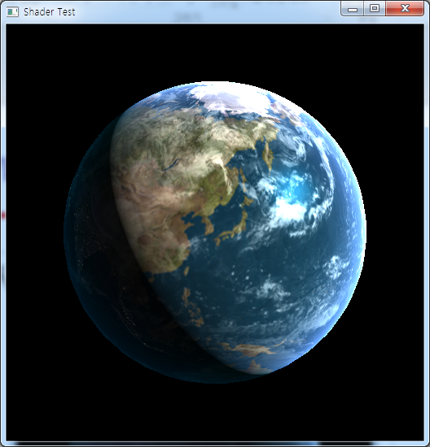
Make your own Planet Earth:

Slide 7
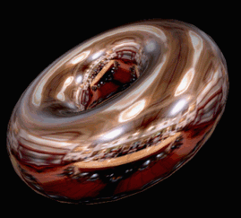
Environmental Mapping

Slide 8
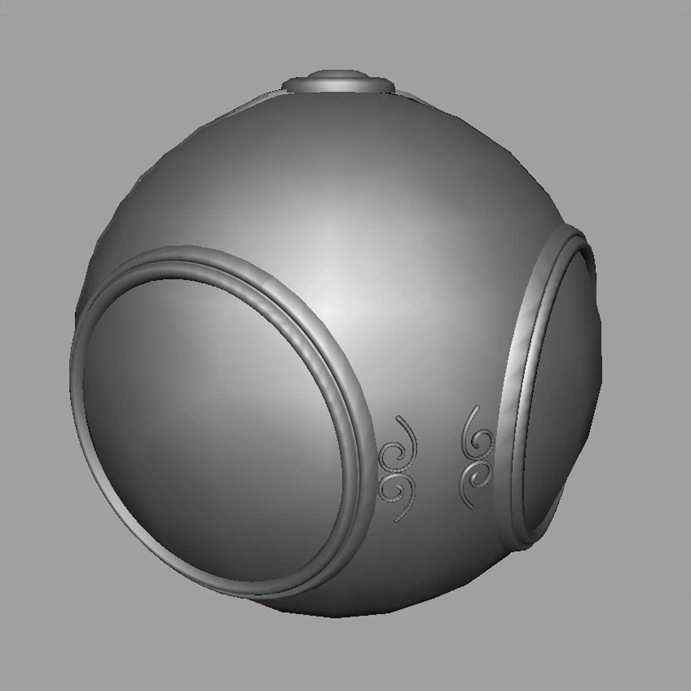
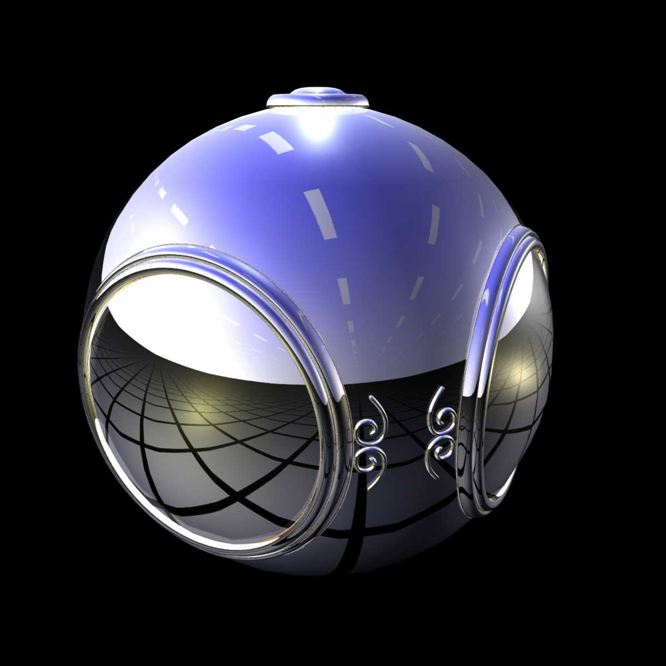
Example

Slide 9
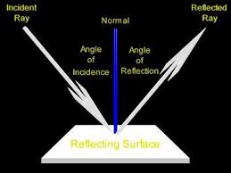
Key observation: Parameterization
Directions
Texture coordinates

Slide 10
Parameterization
Spherical
Cubic

Slide 11
Reflecting the Environment
N
V
R

Slide 12
Mapping to a Sphere
N
V
R

Slide 13
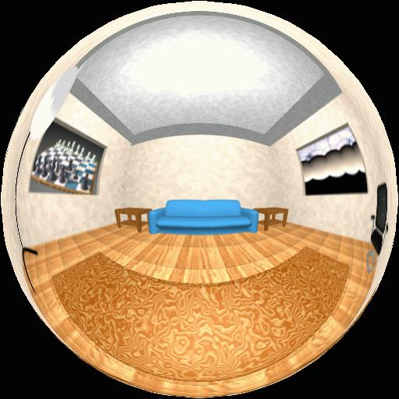
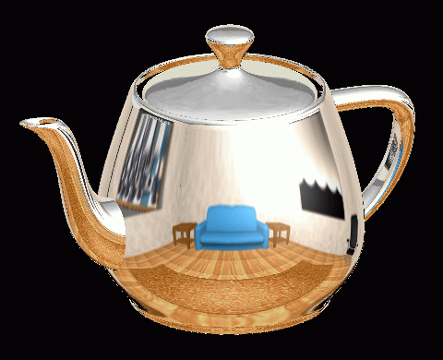
Spherical Map
Original environmental mapping technique proposed by Blinn and Newell.

Slide 14
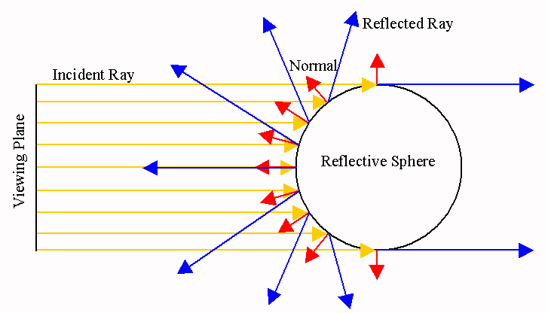
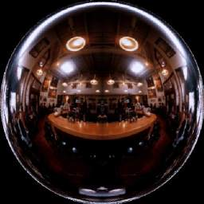
Spherical Environ. Mapping
image of perfect sphere reflector seen from infinity (orthographic)

Slide 15
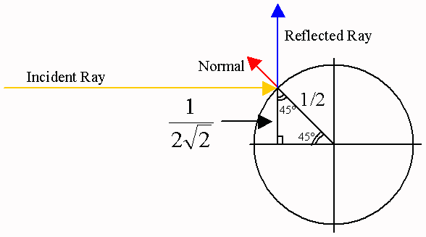
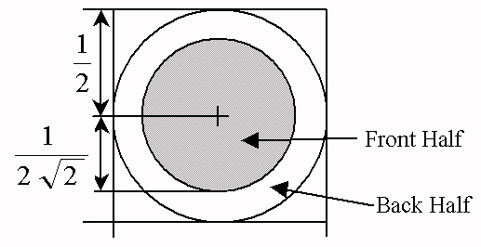
Non-uniform Sampling

Slide 16
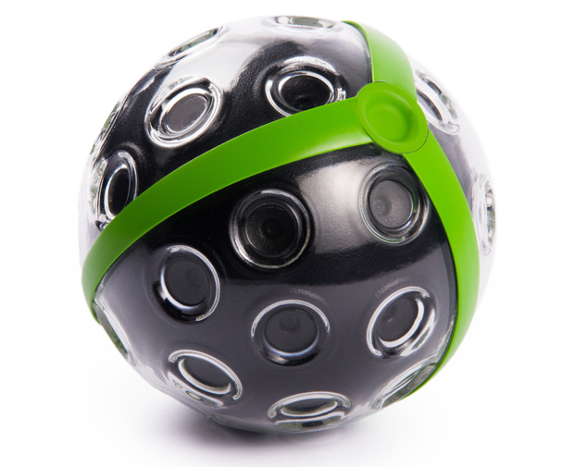
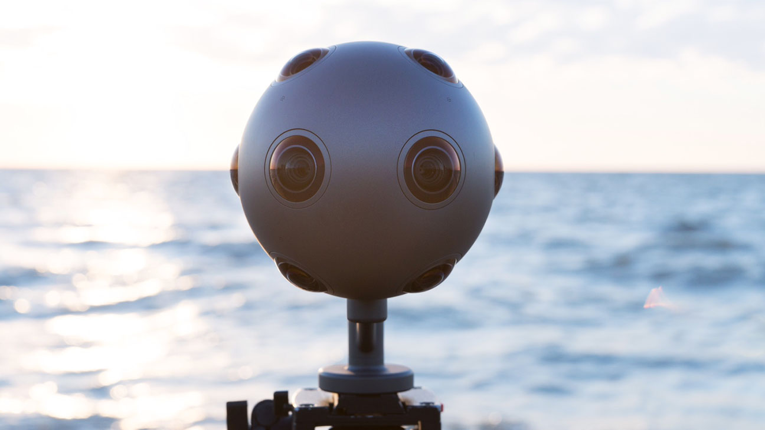
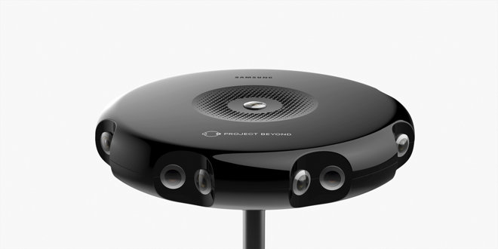
Today: Spherical Cameras are coming!
panono
Nokia Ozo
Samsung project beyond

Slide 17
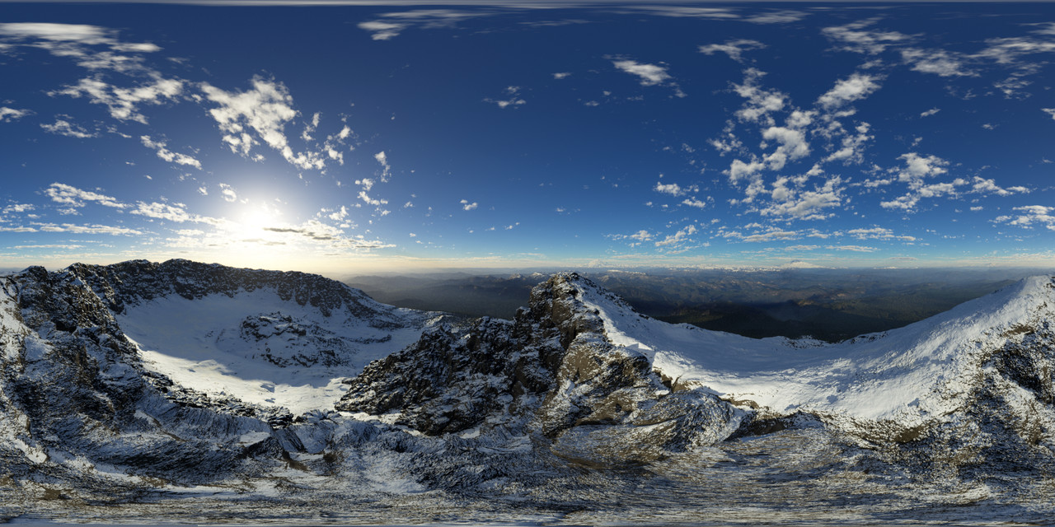
A image from a 360 camera
panorama image

Slide 18
Cube Map

Slide 19
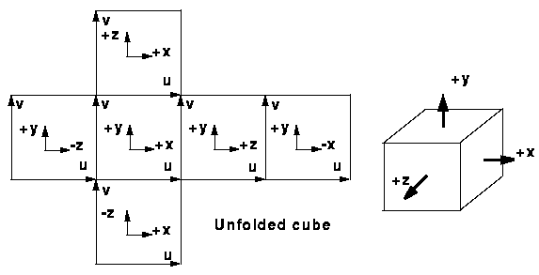
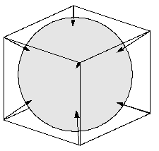
Cube Mapping
a simplified method uses the surface normal as an index for the texel on the cube surface

Slide 20
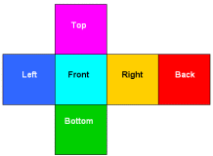
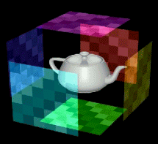
Cube Environment Mapping

Slide 21
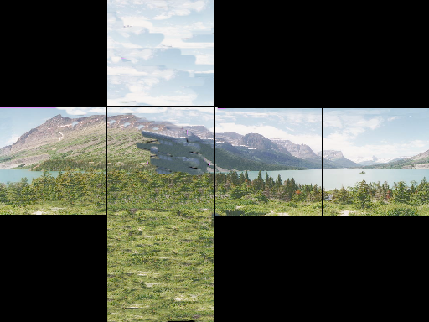
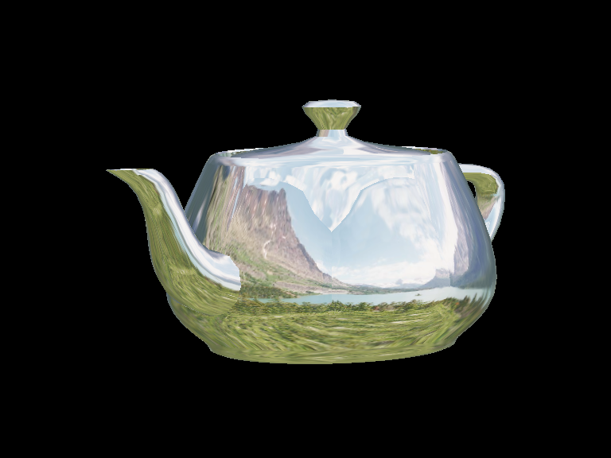
Cube Environment Mapping

Slide 22
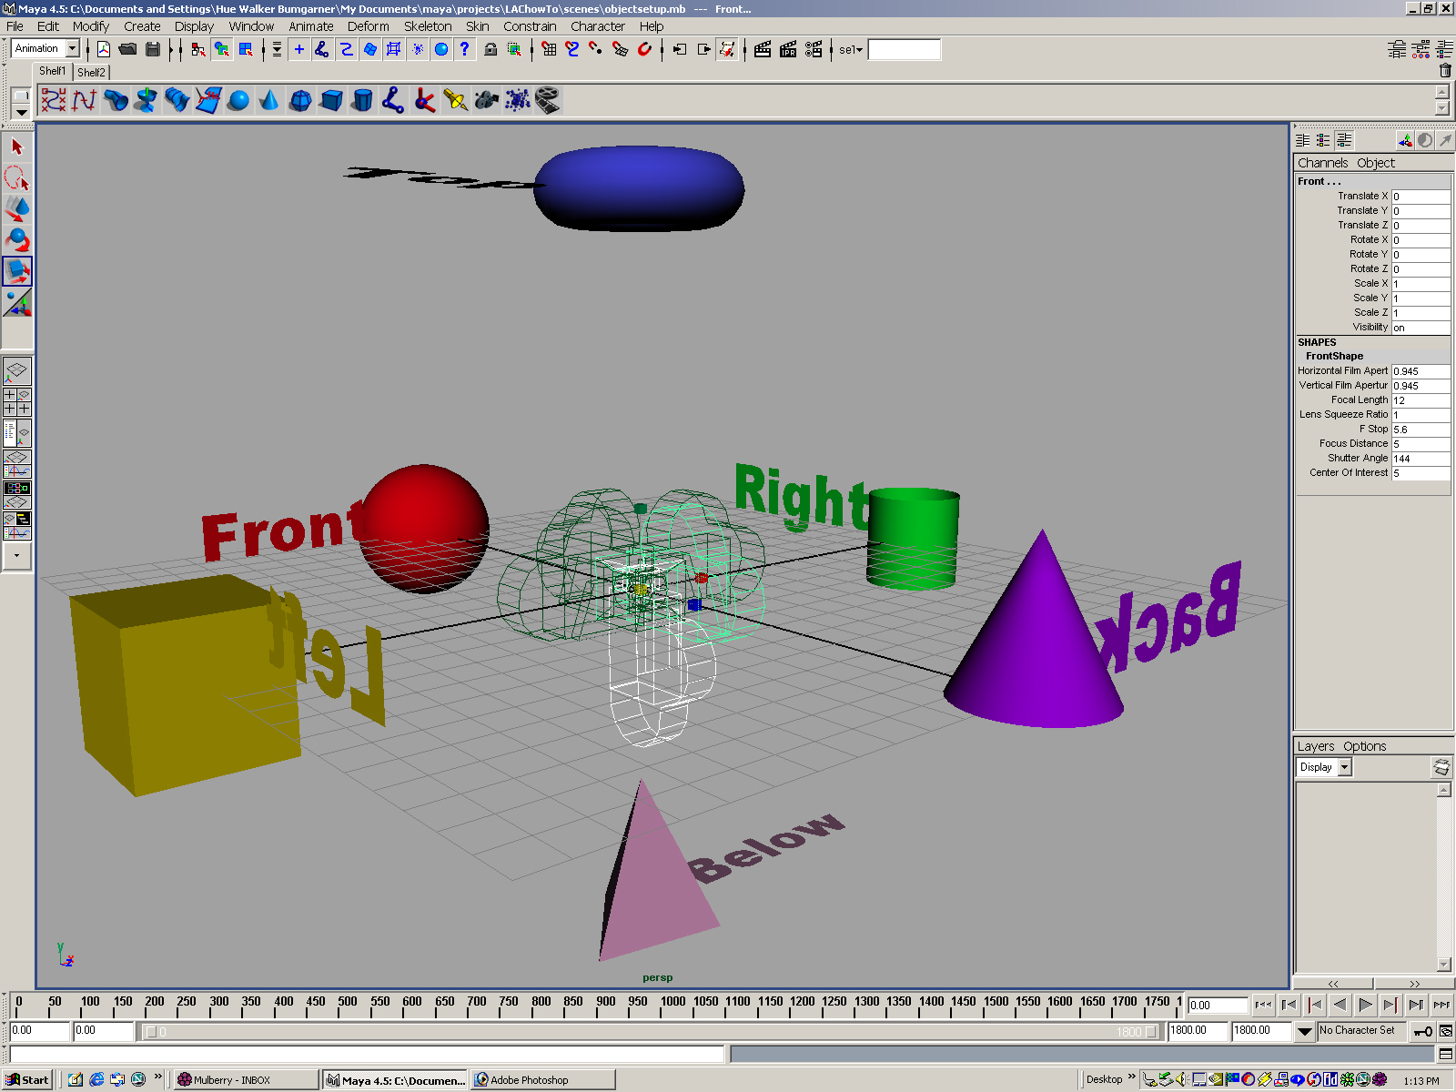
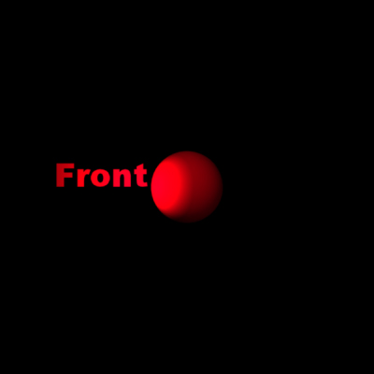

Forming Cube Map
Use six cameras, each with a 90 degree angle of view.
Good place to find cubemaps:
http://www.humus.name/index.php?page=Textures

Slide 23
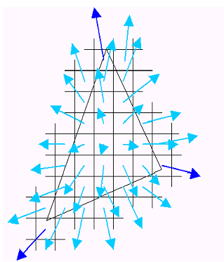
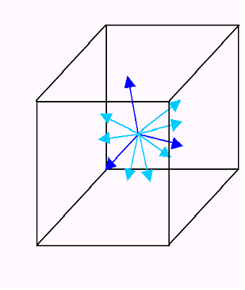
Cube Maps assumption

Slide 24
Indexing into Cube Map
Compute R = 2(N·V)N-V
Object at origin.
Use largest magnitude component of R to determine face of cube.
Other two components give texture coordinates.
V
R

Slide 25
Example
R = (-4, 3, -1). Same as R = (-1, 0.75, -0.25)
Use face x = -1 and y = 0.75, z = -0.25
Not quite right since cube defined by x, y, z = ± 1 rather than [0, 1] range needed for texture coordinates.
Remap by s = ½ + ½ y, t = ½ + ½ z
Hence, s =0.875, t = 0.375

Slide 26
Issues
Must assume environment is very far from object (equivalent to the difference between near and distant lights).
Object cannot be concave (no self reflections possible).
No reflections between objects.
Need a reflection map for each object.

Slide 27
OpenGL Implementation
OpenGL supports spherical and cube maps.
First, form map :
Use images from a real camera.
Form images with OpenGL.
Texture map it on to object.

Slide 28
Cubemap in OpenGL
Preparation: Make one texture object out of the six images.
Load 6 Images (image1, image2, … image 6) and send it to GPU
Same for other five images.
GLuint cubeMap;
glGenTextures(1, &cubeMap);
glActiveTexture(GL_TEXTURE0);
glBindTexture(GL_TEXTURE_CUBE_MAP, cubeMap);
glTexImage2D(GL_TEXTURE_CUBE_MAP_POSITIVE_X,
level, GL_RGB, width, height, border,
GL_RGB, GL_UNSIGNED_BYTE, image1);

Slide 29
OpenGL Cube Map (cont)
Parameters apply to all six images.
Same for t and r.
Note that texture coordinates are in 3D space (s, t, r).
Set the filtering options too.
glTexParameteri(GL_TEXTURE_CUBE_MAP,
GL_TEXTURE_MAP_WRAP_S, GL_REPEAT);
glTexParameteri(GL_TEXTURE_CUBE_MAP,
GL_TEXTURE_MAG_FILTER, GL_LINEAR);
glTexParameteri(GL_TEXTURE_CUBE_MAP,
GL_TEXTURE_MIN_FILTER, GL_LINEAR);

Slide 30
In Fragment Shader
Using uniform variable of “samplerCube”
#version 430
in vec4 dir;
out vec4 fColor;
uniform samplerCube uCubeTex;
void main()
{
fColor = texture(uCubeTex, dir);
}

Slide 31
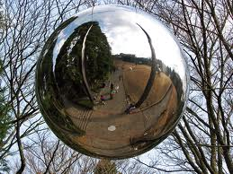
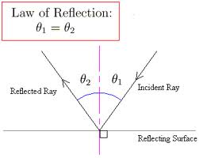
Reflection
R = 2(N·V)N-V

Slide 32
In Fragment Shader
Using the function “reflect”
view_dir: direction from the eye to the position in world coord. view_dir = position – eye_positoin
Normal: normal vector of the surface in world coord.
vec3 dir = reflect(view_dir, normal);
fColor = texture(uCubeTex, dir);

Slide 33
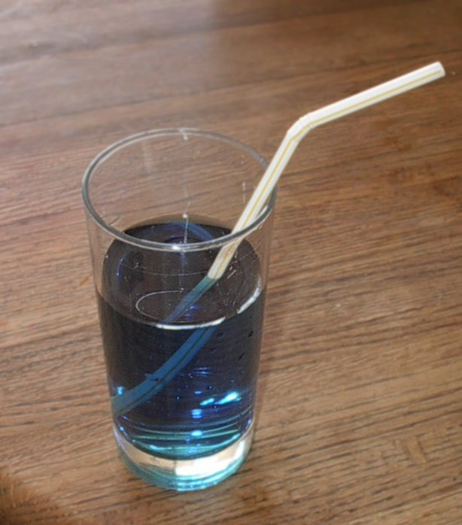
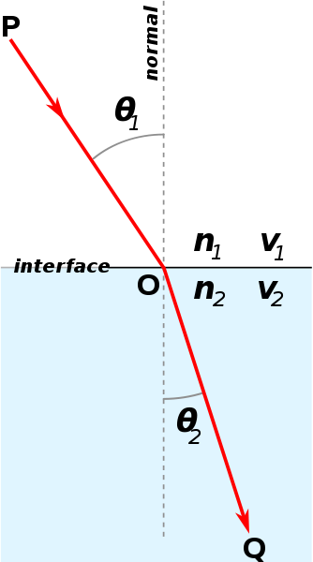
Refraction
Snell’s law
n: speed of light
(refractive index)
- air = 1
- water = 1.333
http://www.youtube.com/watch?v=gwggONU0QZQ

Slide 34
In Fragment Shader
Using the function “refract”
Refractive index:
Example: from air to water = 1/1.3 from water to air = 1.3/1
vec3 dir = refract(view_dir, normal, index);
fColor = texture(uCubeTex, dir);

Slide 35
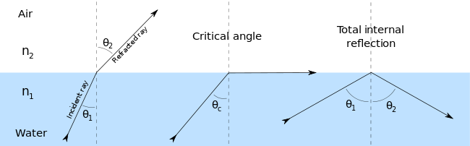
Issue:
Critical angle of refraction
????
Refraction becomes Reflection

Slide 36
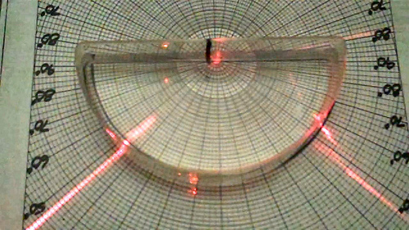
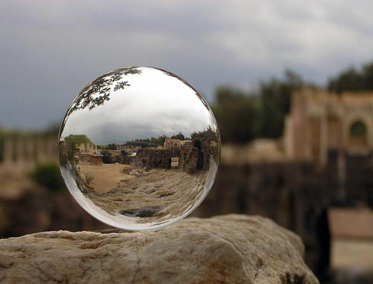
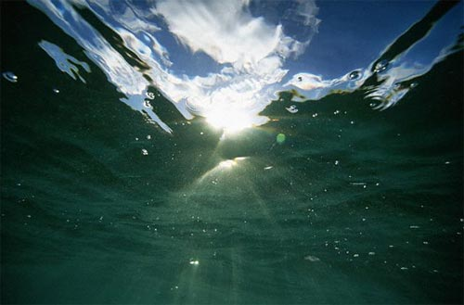
Issue:
Critical angle of refraction in real world

Slide 37
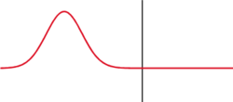
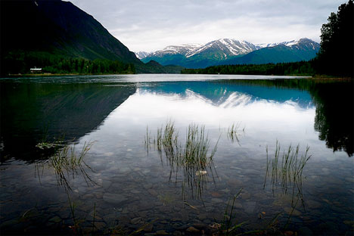
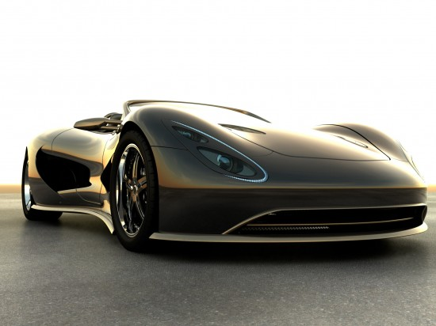
Fresnel Effect
Fresnel equation describe the movement of light in different media.

Slide 38
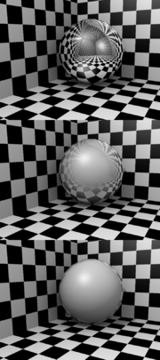
Fresnel Equation
Equation about how strong the reflect effect is:
Coefficient n ≈ (0.5~10) larger n : smaller reflect smaller n : stronger reflect
The reflection strength depends on the incident angle!
fr = offset + scale * (1+ V∙N)^{n}
small
기본값≈0
가중치≈(0.1~0.5)
n
large

Slide 39
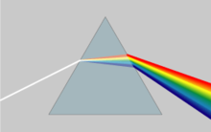



Chromatic dispersion (aberration)
Light separates in many colors because of the refraction of each color is different.

